Slide 1
Instrumentation Rapid Prototyping using LabVIEW and Arduino High-Precision Measurement Shield
Carmine Paolino (1156420)
Tutor: Prof. Chen Kangli
Tongji University - 15 June 2017

Slide 2
The location
China Innovation Center
Focus on Biology, Chemistry and Engineering
R&D and training center
Created by Thermo Fisher Scientific
Prototypes are important
Need to build them fast and efficiently

Slide 3
Some problems
Each measurement devices has its own interface
It takes time to configure a new platform
Time-to-prototype is critical for project development
Prototyping platforms may have limited performances

Slide 4
Solution (1)
Common platform managing the devices
Intuitive graphical interface
Most widely used acquisition parameters
Implemented as a LabVIEW software
Continuous Acquisition Framework

Slide 5
Solution (2)
Extension boards can provide extended functionalities
Sigma delta ADCs allow to measure with up to 22 bits of resolution
PCB designed to improve Arduino microcontroller boards
Arduino Measurement Shield

Slide 6
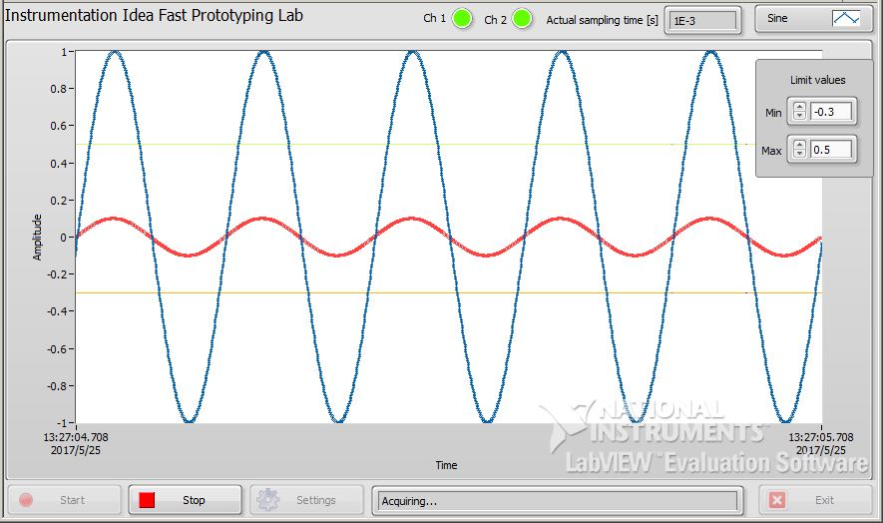
Continuous acquisition framework
Forked from a National Instruments’ sample project
New devices and functionalities have been added
Some more to come

Slide 7
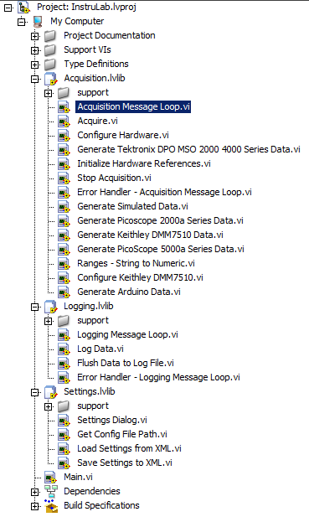
Continuous acquisition framework > Hierarchy
Main.vi
Settings.vi
Acquisition Message Loop.vi
Keithley DMM 7510
PicoTech PicoScope 2000a series
and many more files…

Slide 8
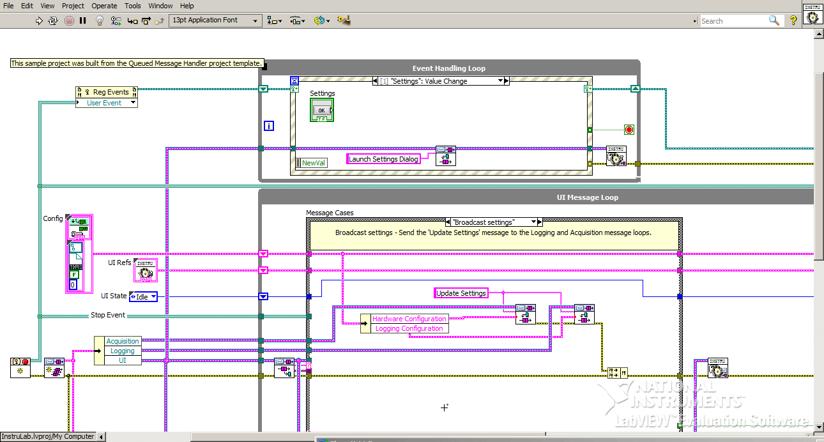
Main.vi > Block Diagram

Slide 9
Main.vi > Abstract View
Event Handling Loop
Event Handling loop
UI Message loop
Acquisition Message loop
Logging Message loop
Data Display loop
UI queue
UI Message
Loop
Acquisition
and UI queue
Logging
and UI queue
Acquisition Message Loop
Logging Message Loop
Data queue
Data notifier
Data Display Loop

Slide 10
Main.vi > Implementation Details
Notifier data structure
Lossy
Non-blocking
Broadcast
Visual indicators managed by global variables
Accessible anywhere
Definition in front panel only

Slide 11
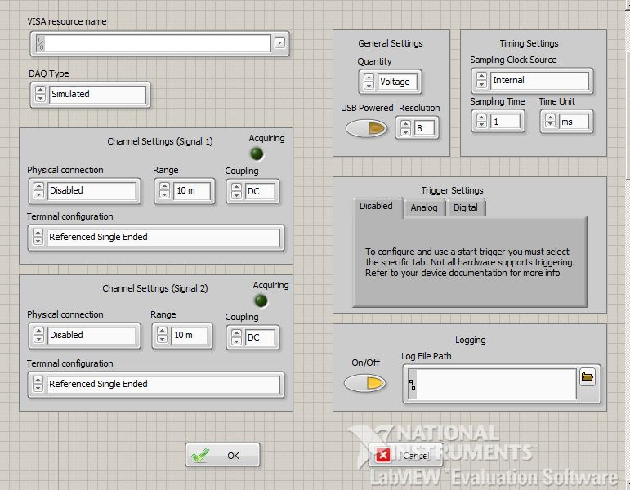
Settings Dialogue.vi
Configured before acquiring
Common parameters
Range
Coupling
Sampling Time
...
Device-dependent options
Avoid configuration errors
More work for the programmer

Slide 12
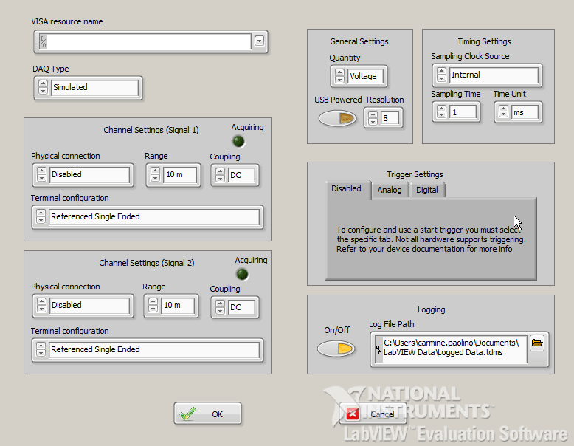
Settings Dialogue.vi > DAQ Value Change Event
Changing DAQ Type triggers options update
Each device has its own
Need to specify them when adding a new one

Slide 13
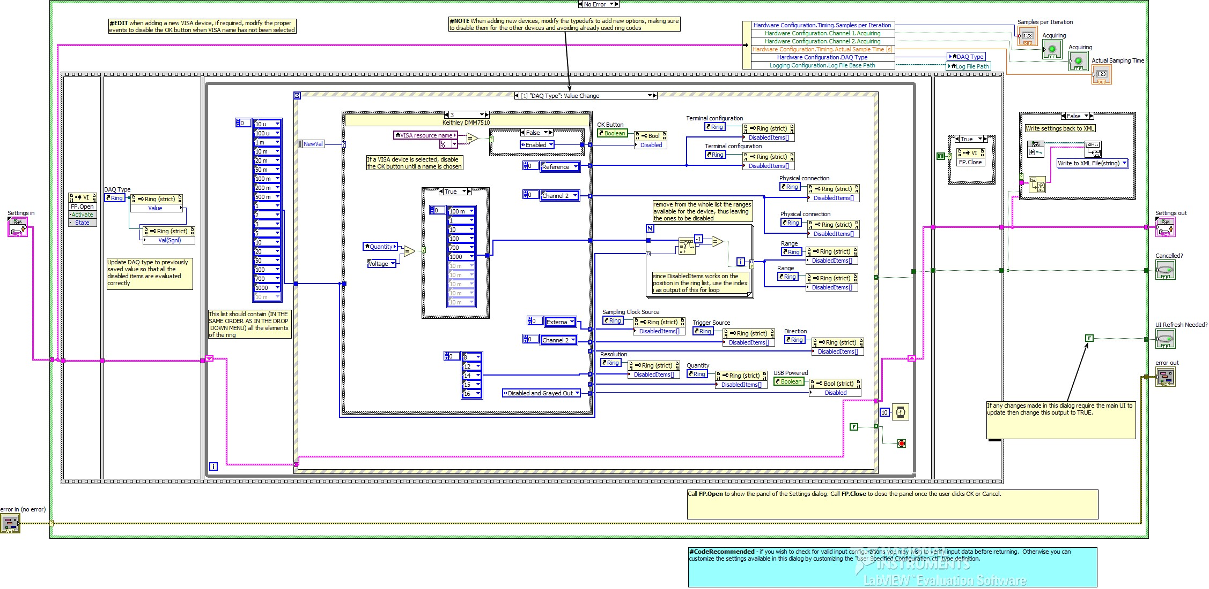
Settings Dialogue.vi > DAQ Value Change (2)

Slide 14
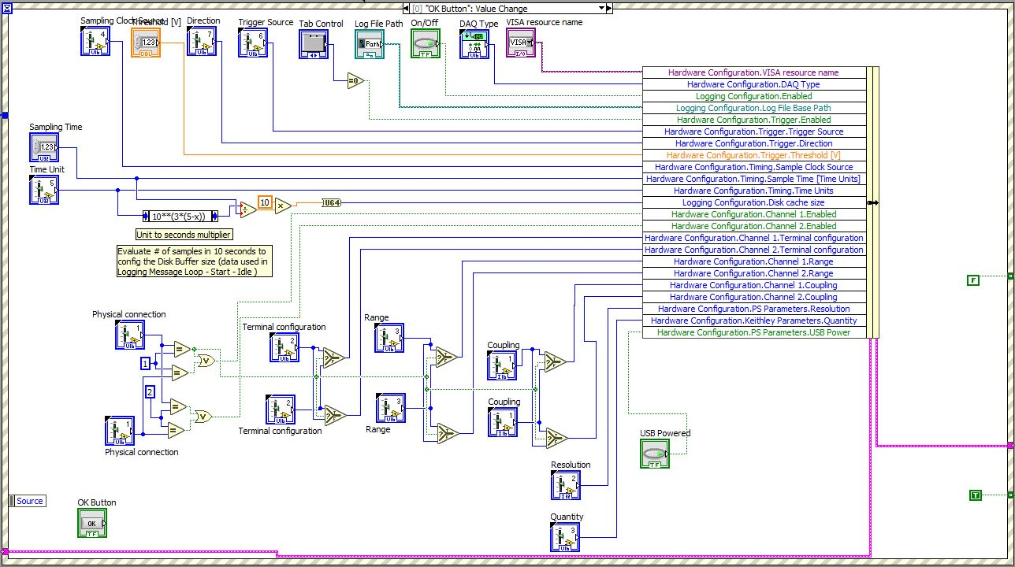
Settings Dialogue.vi > OK Button Value Change

Slide 15
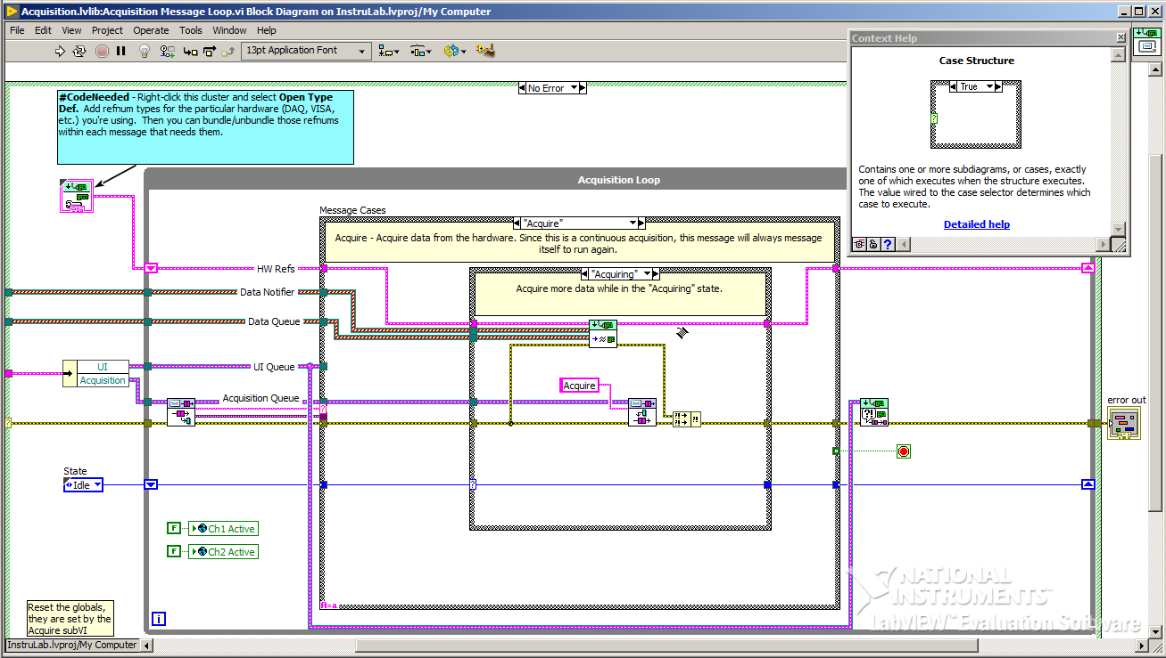
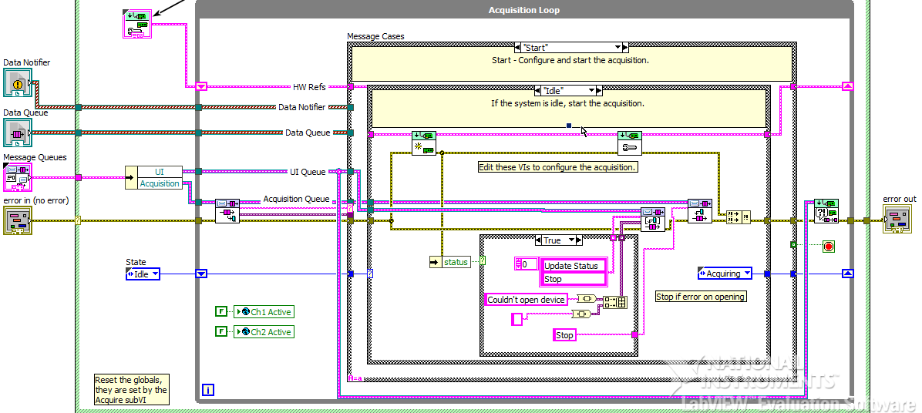
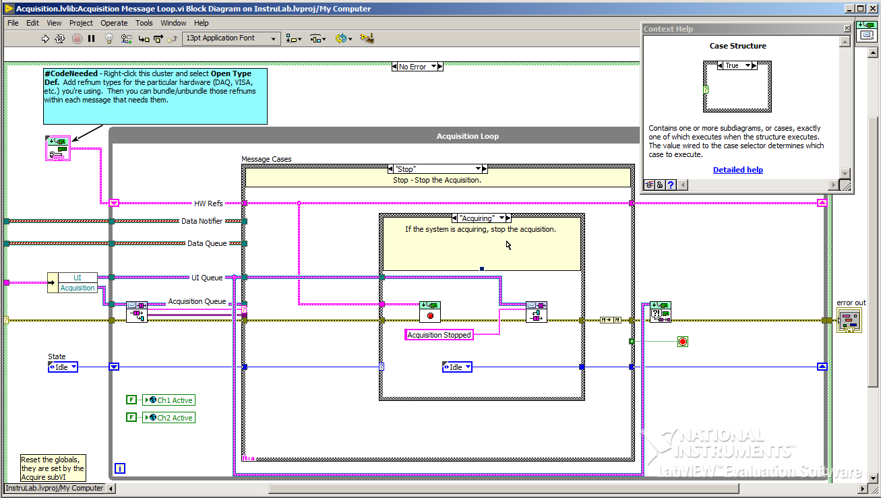
Acquisition Message Loop.vi
Every state calls a sub-VI
Every sub-VI has a case structure
switch (DAQ Type){…}
State = START
State = ACQUIRE
State = STOP

Slide 16
DAQ Type 1 > Keithley DMM7510
Device specifications
SCPI interface
Configuration commands
Retrieval commands
Wrapping pseudocode
Extending the framework

Slide 17
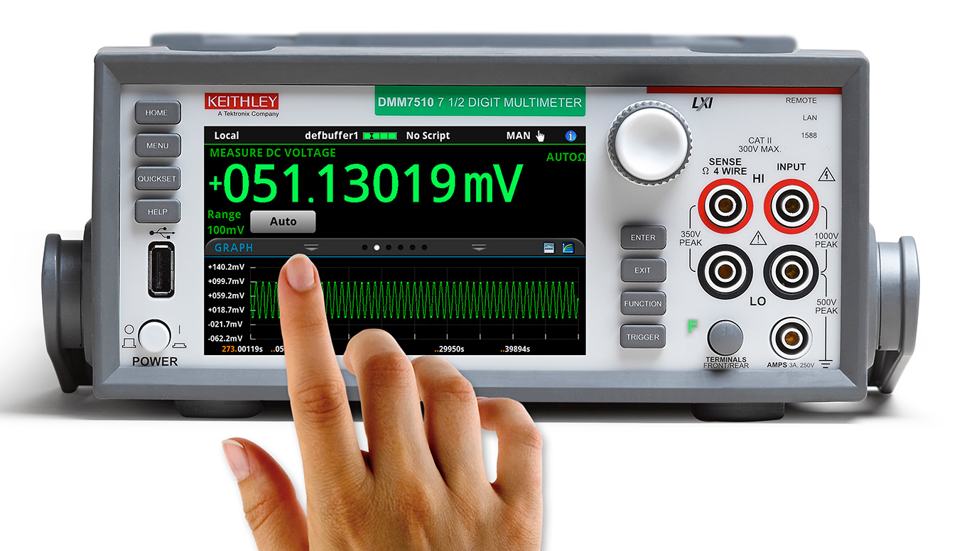
DMM7510 > Device specifications
7 ½ digits DMM
nV and pA sensitivity
1,000,000 readings/s
Touch screen display
USB connectivity
Support for SCPI commands

Slide 18
DMM7510 > SCPI interface
Standards Commands for Programmable Instruments
Developed on top of the IEEE 488.2 standard
Tree-like structure
SENS1:VOLTage:DC:RANGe 10 // set DC voltage range to 10

Slide 19
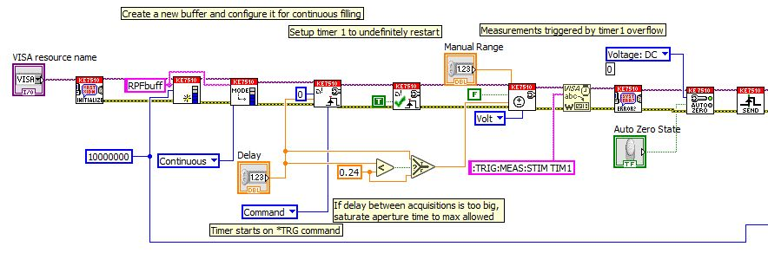
DMM7510 > Configuration commands
TRAC:MAKE “RPFbuff” 10000000 // create user buffer
TRAC:FILL:MODE CONT “RPFbuff” // wrap around when full
TRIG:TIM1:COUN 0; // restart Timer1 indefinitely
TRIG:TIM1:DEL <samplingTime>; // define overflow period
TRIG:TIM1:STIM COMM // start on software trigger
TRIG:TIM1:STAT ON // enable timer trigger state
SENS1:VOLT:DC:RANG <manualRange>; // setup DC voltage range
SENS1:VOLT:DC:APER <max(0.24, samplingTime)>; // select resolution
TRIG:MEAS:STIM TIM1 // sample on Timer1 overflow
VOLT:DC:AZERo:STATe OFF // disable the autozero feature
*TRG // send Software Trigger
Test.vi: configuration

Slide 20
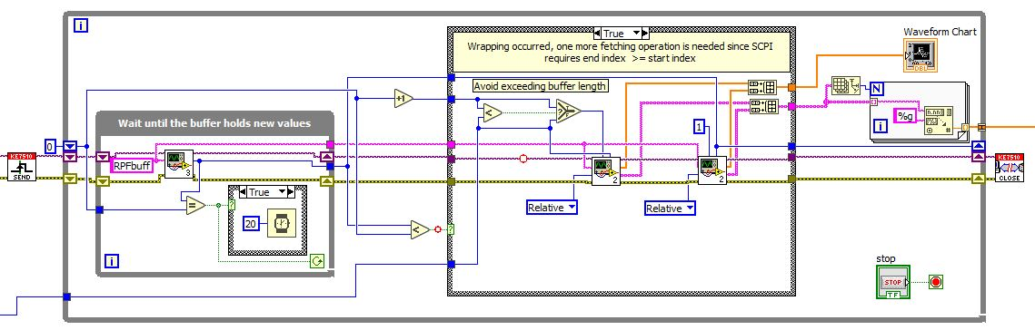
DMM7510 > Retrieval commands
TRAC:ACT:END? “RPFbuff” // get last element index
TRACE:DATA? <previousIndex+1>, <currentIndex>, “RPFbuff”, REL
/* Returns a string, which is a sequence as below
“<sample1_str>,<time1_str>,<sample2_str>,<time2_str>,…” */
Test.vi: acquisition

Slide 21
DMM7510 > Wrapping pseudocode
What happens when wrapping around?
End index must be greater than start index
if Current_Index < Previous_Index then
Fetch_Buffer[Previous_Index + 1:Current_Index]
else
Fetch_Buffer[Previous_Index + 1:Buffer_Size]
Fetch_Buffer[1:Current_Index]
end

Slide 22
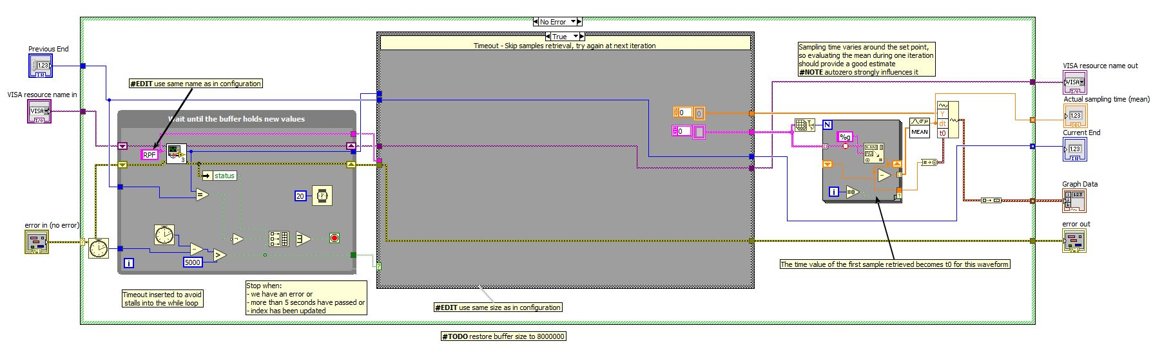
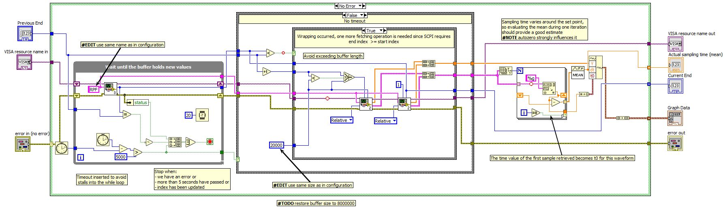
DMM7510 > Extending the framework
Configure Hardware.vi > Configure DMM7510.vi
Acquire.vi > Generate DMM7510 Data.vi

Slide 23
DAQ Type 2 > PicoTech PicoScope 2000a Series
Device specifications
LabVIEW streaming example
Accessing Memory buffers
Controlling the Timing
Calibrating the Device

Slide 24
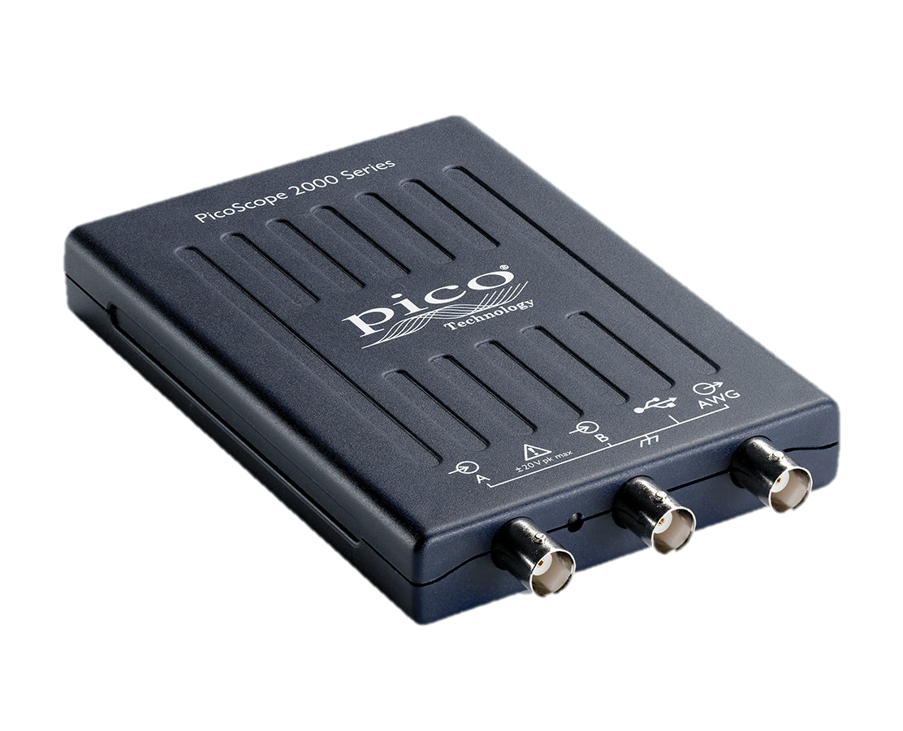
PS2000a > Device specifications
2 channels
100 MHz bandwidth
1 Gsps
8 kS to 128 MS memory capacity

Slide 25
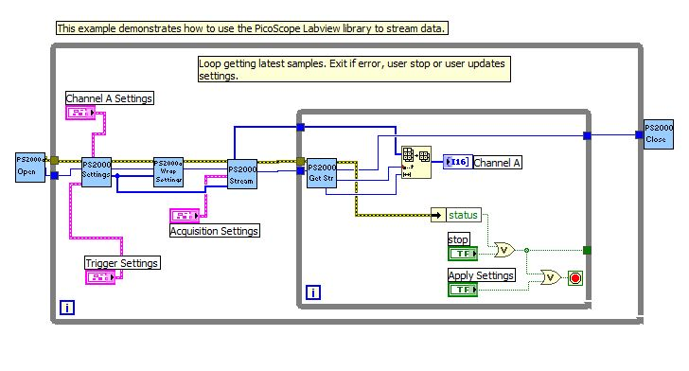
PS2000a > LabVIEW streaming example
C-language API
Reserved memory buffer
What happens when splitting configuration and acquisition in different subVIs?
PicoScope2000aExampleStreaming.vi

Slide 26
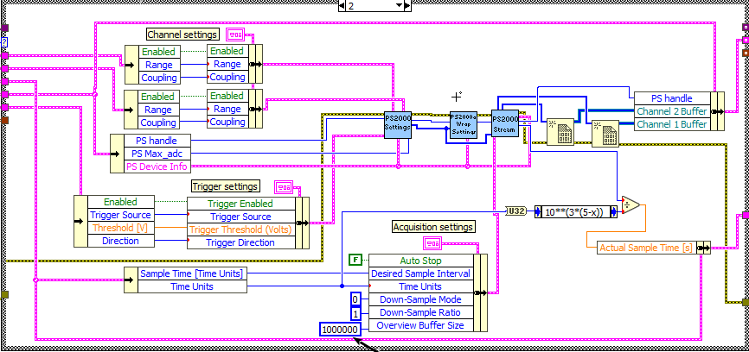
PS2000a > Accessing Memory buffers
Values are copied into the cluster
The copy has a different address
Can’t get the samples anymore!
Configure Hardware.vi > PS2000a case

Slide 27
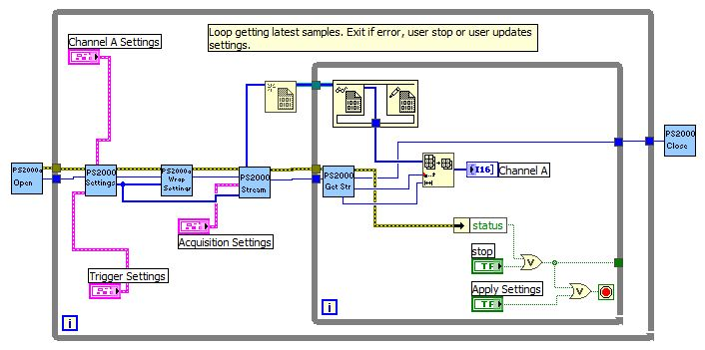
PS2000a > Accessing Memory buffers (2)
Create reference
In-place structure to dereference
Equivalent to C pointers operations
What about the relative timing?
---
Updated example

Slide 28
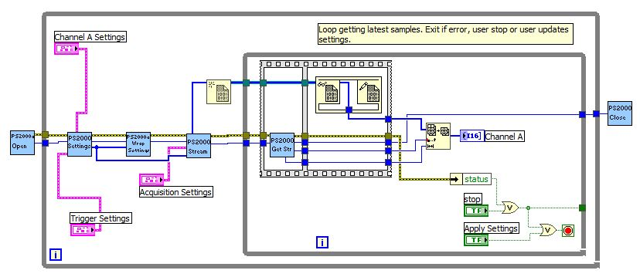
PS2000a > Controlling the Timing
Order of operation matters
Ad-hoc structure required to enforce it
Finally it works!
Definitive version

Slide 29
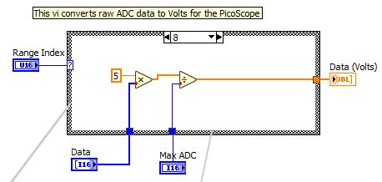
PS2000a > Calibrating the Device
The device returns ADC counts (not Volts)
A sub-VI performs the conversion
It gives us access to the calibration constants
PS2000ADCtoVolts.vi

Slide 30
6 Arduino Measurement Shield PCB Design
Arduino
Design objectives
AD7176-2
Schematic – signal
Schematic – auxiliary
Placement & Routing
Layers
Updates
Serial interface
Communication reliability

Slide 31
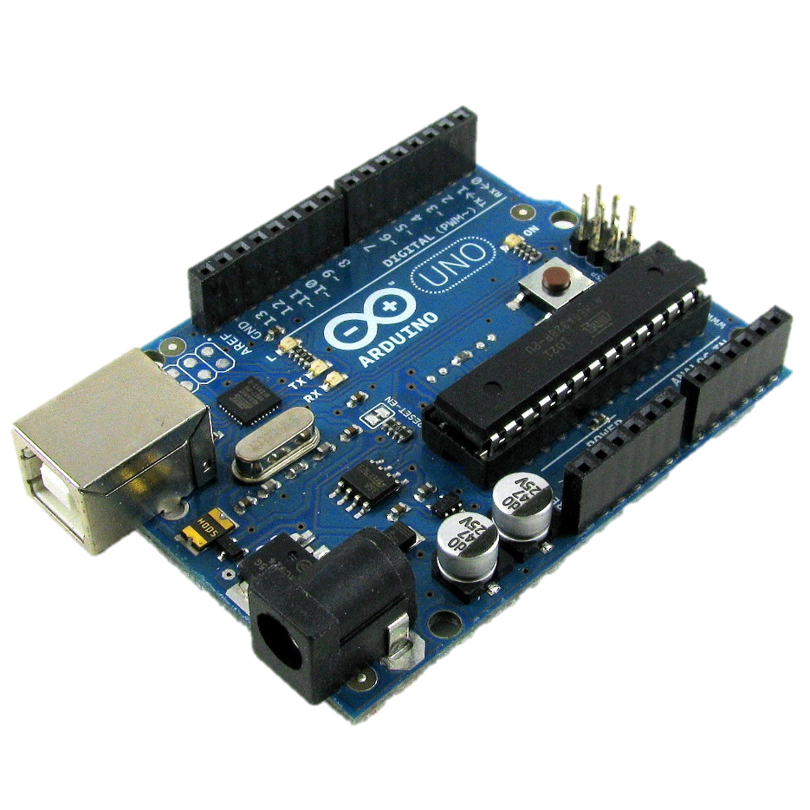
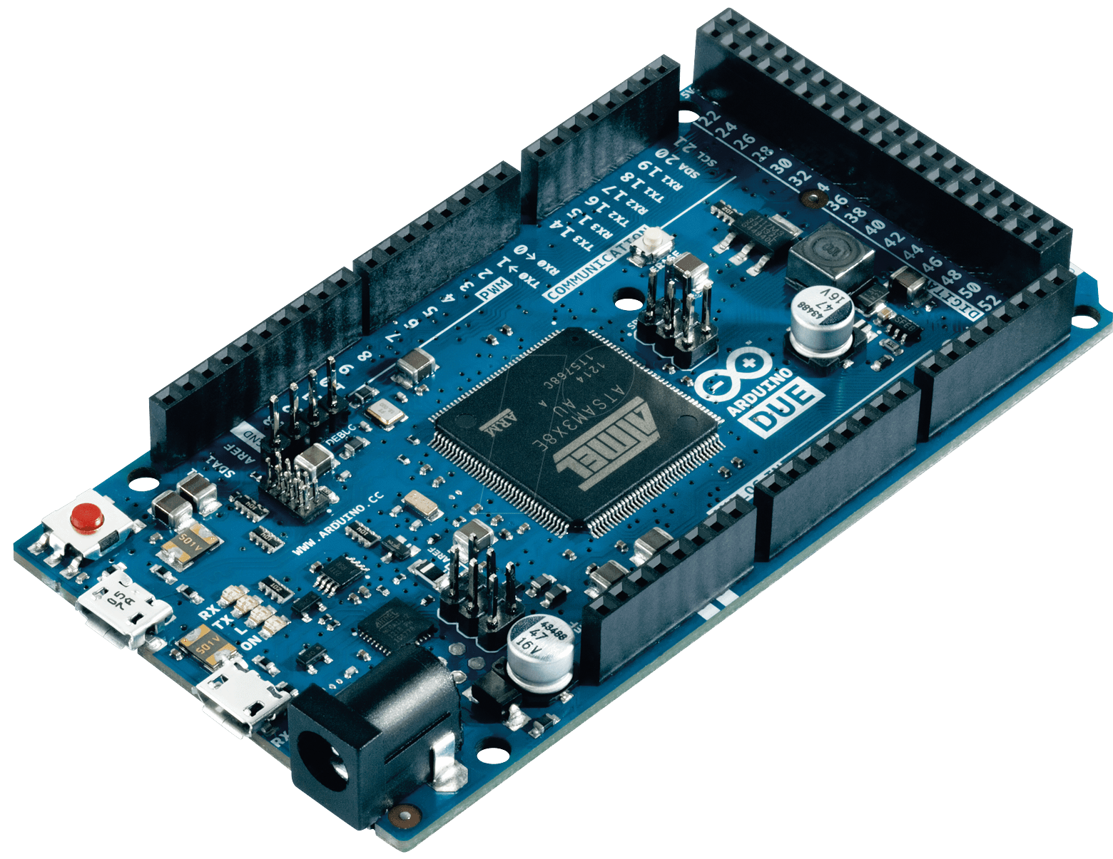
Arduino
Arduino UNO
Low cost microcontroller boards
8 bit @ 16 MHz up to 32 bit @ 84 MHz
5 V vs 3.3 V
14 vs 54 I/O lines
IDE and libraries
Shields
Arduino DUE

Slide 32
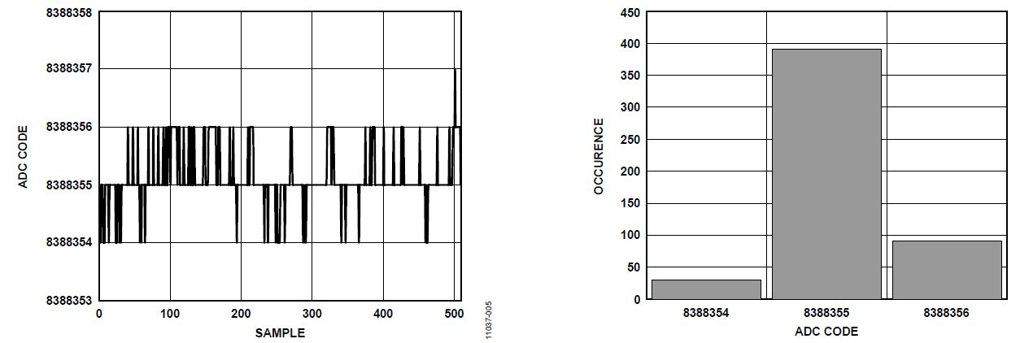
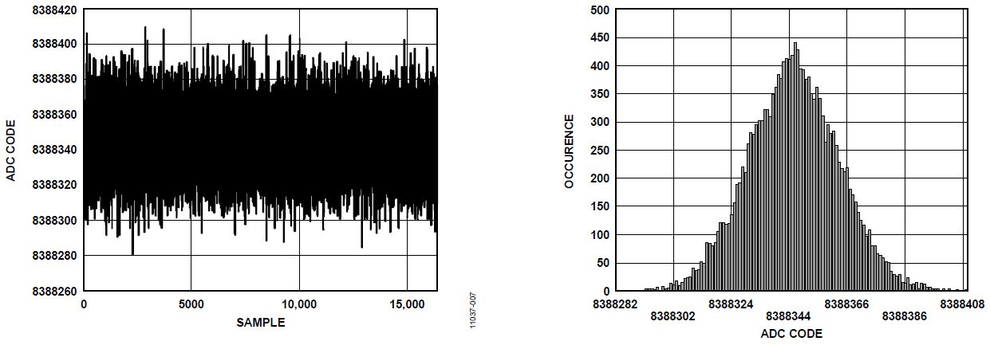
Design objectives
16 noise-free bits
250 ksps
Signals up to 5 V
Can we make it?
AD7176-2: 5 sps
AD7176-2: 250 ksps

Slide 33
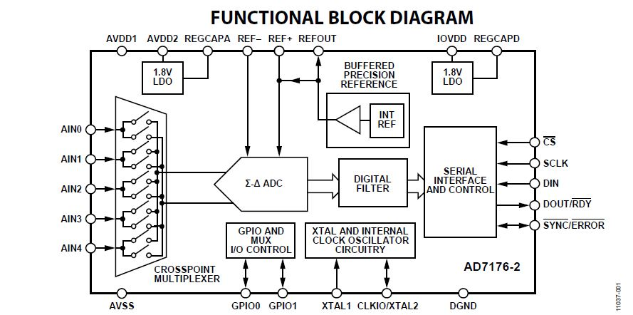
AD7176-2
Sigma delta ADC
22 noise free bits at 5 sps
or 16 bits at 250 ksps.
Single ended or differential configuration
Internal or external references and clock
SPI digital interface

Slide 34
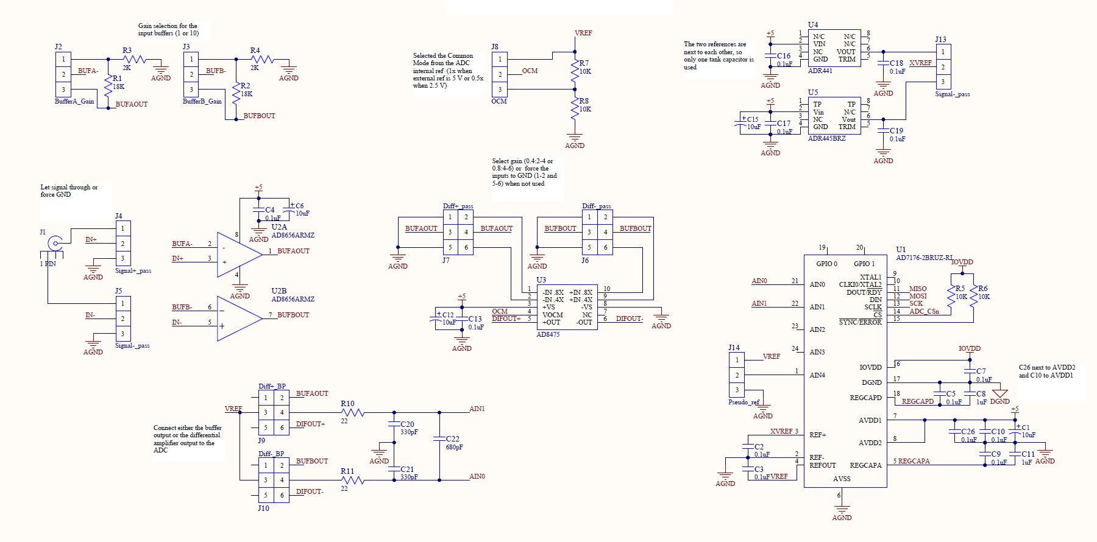
Schematic Diagram – Signal

Slide 35
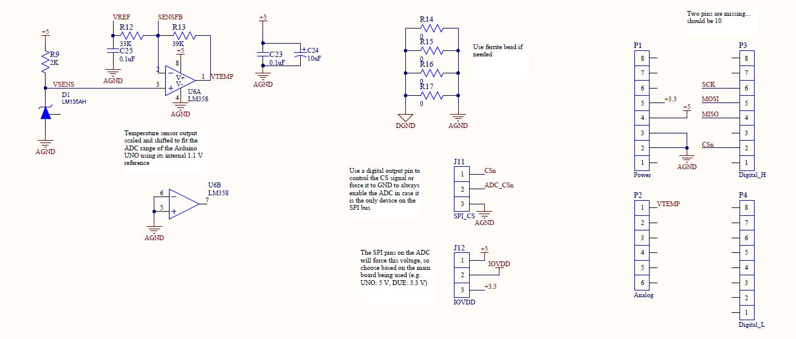
Schematic Diagram – Auxiliary

Slide 36
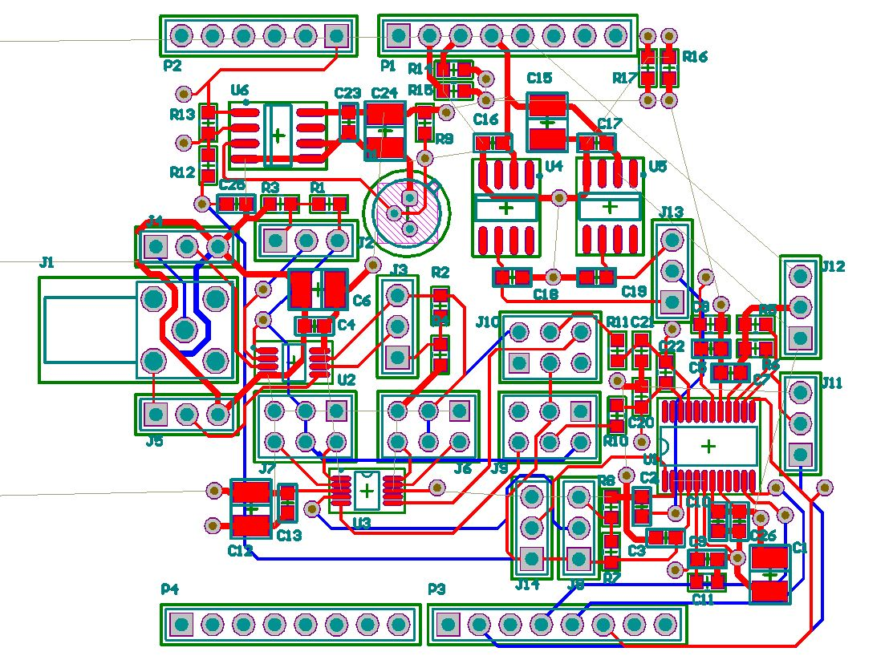
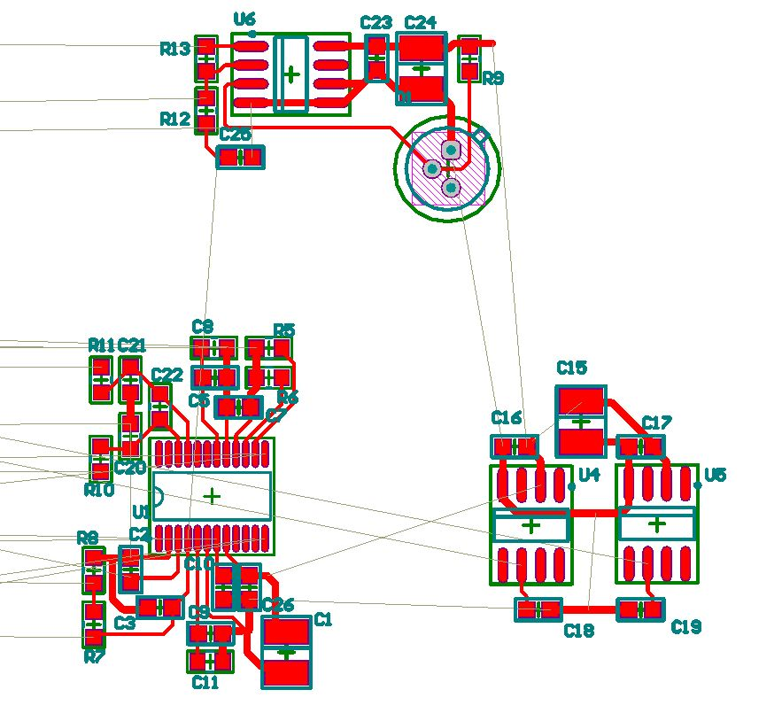
Placement & routing
Submodules
Complete placement

Slide 37
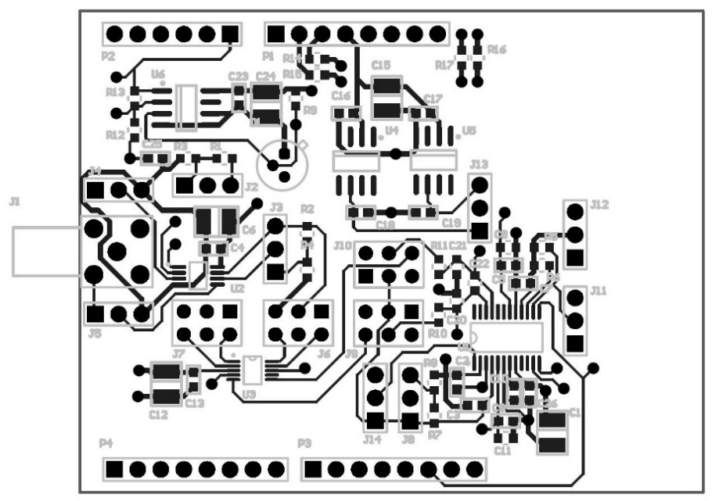
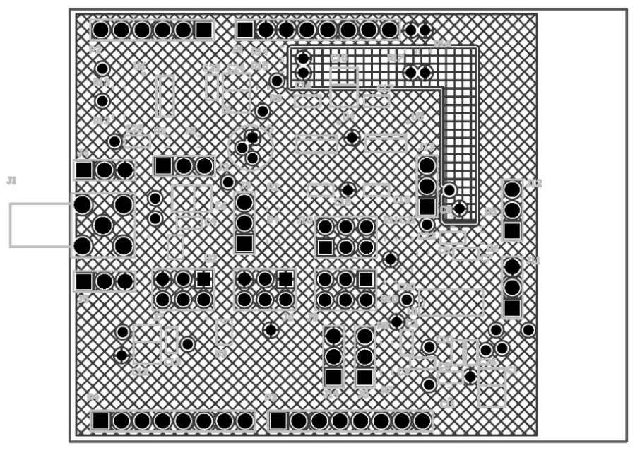
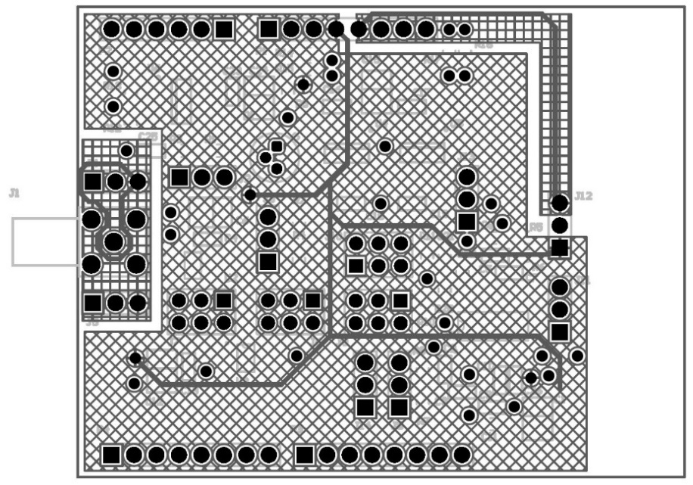
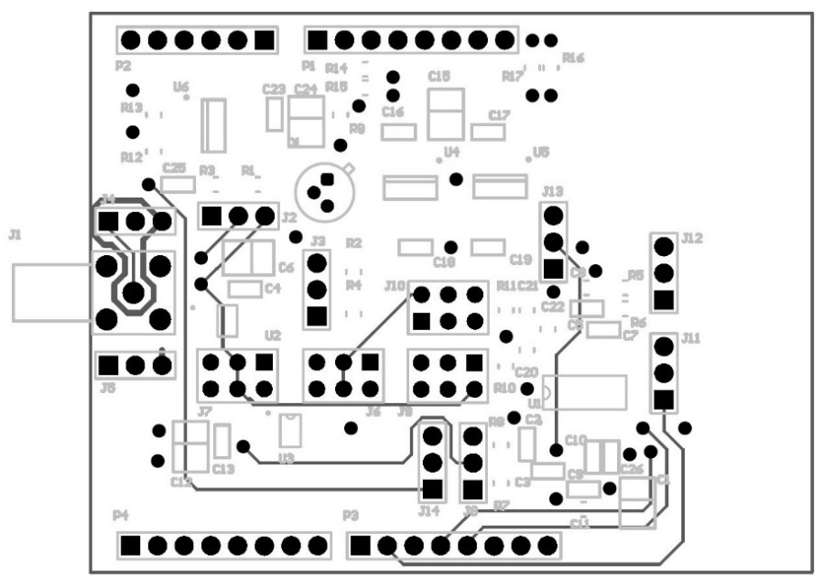
Layers
TOP
MidLayer2
MidLayer1
BOTTOM

Slide 38
Updates > New revision
5 V reference dropout
→ use DC input
IOVDD noise
→ separate supplies through a new power stage
Noise introduced by jumpers
→ no gain selection on input buffers
Increased precision on temperature measurement
→ voltage divider on the sensor voltage to center the dynamic in [0; 1.1] V

Slide 39
Serial interface
Only 8N1 or 8N2 mode on Arduino UNO
Samples are 16 bits
→ must be decomposed in 8 bit frames
Each sample becomes two packets
→ 2 x (start + payload + stop) = 20 bit in total
250 ksps sampling rate
→ 5 Mbaud required
BUT reliable communication only up to 1 Mbaud

Slide 40
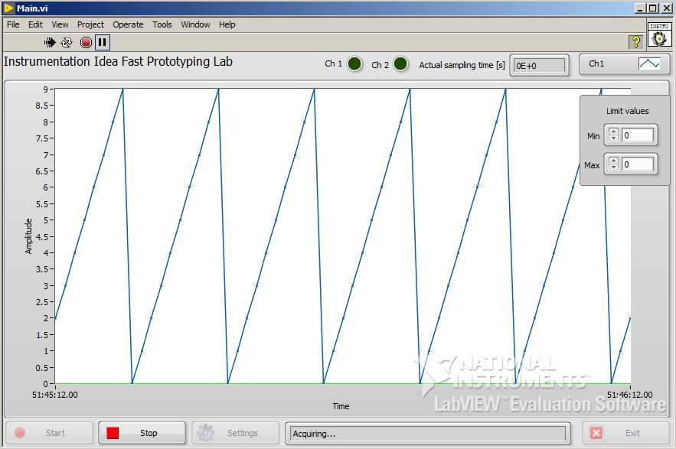
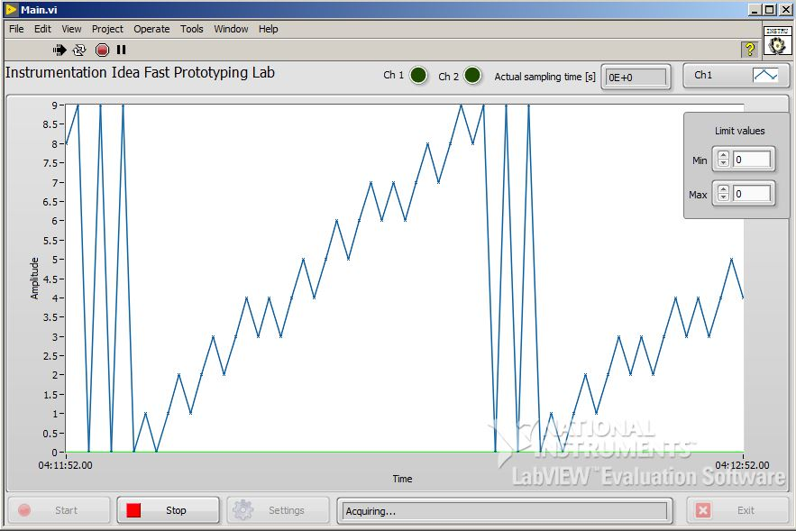
Communication reliability
1 Mbaud
2 Mbaud

Slide 41
The culprit
ATMega16U2
Manages the serial to USB conversion
Has hardware USB peripheral
But a lot of software is involved
(https://github.com/arduino/)
Specialized firmware?
Or may be just a buffer overrun?

Slide 42
Conclusion
Both projects will evolve
Real case testing needed
Basic functionalities already guaranteed

Slide 43
Questions?
…
…

